Slide 1
Informational meeting
Spring 2024
Please use the link below to sign in.
☺
Sign In link

Slide 2
Friendly Reminders
We will be recording this meeting.
Please mute your microphone
Please write down your questions on a piece of paper and ask them via chat AT THE END of the meeting.
Please sign in and I will send you this recording.
Please SIGN-IN HERE!
☺

Slide 3
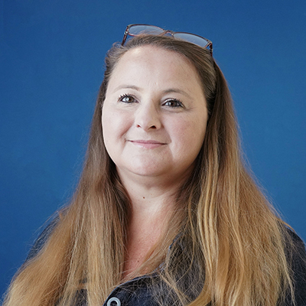
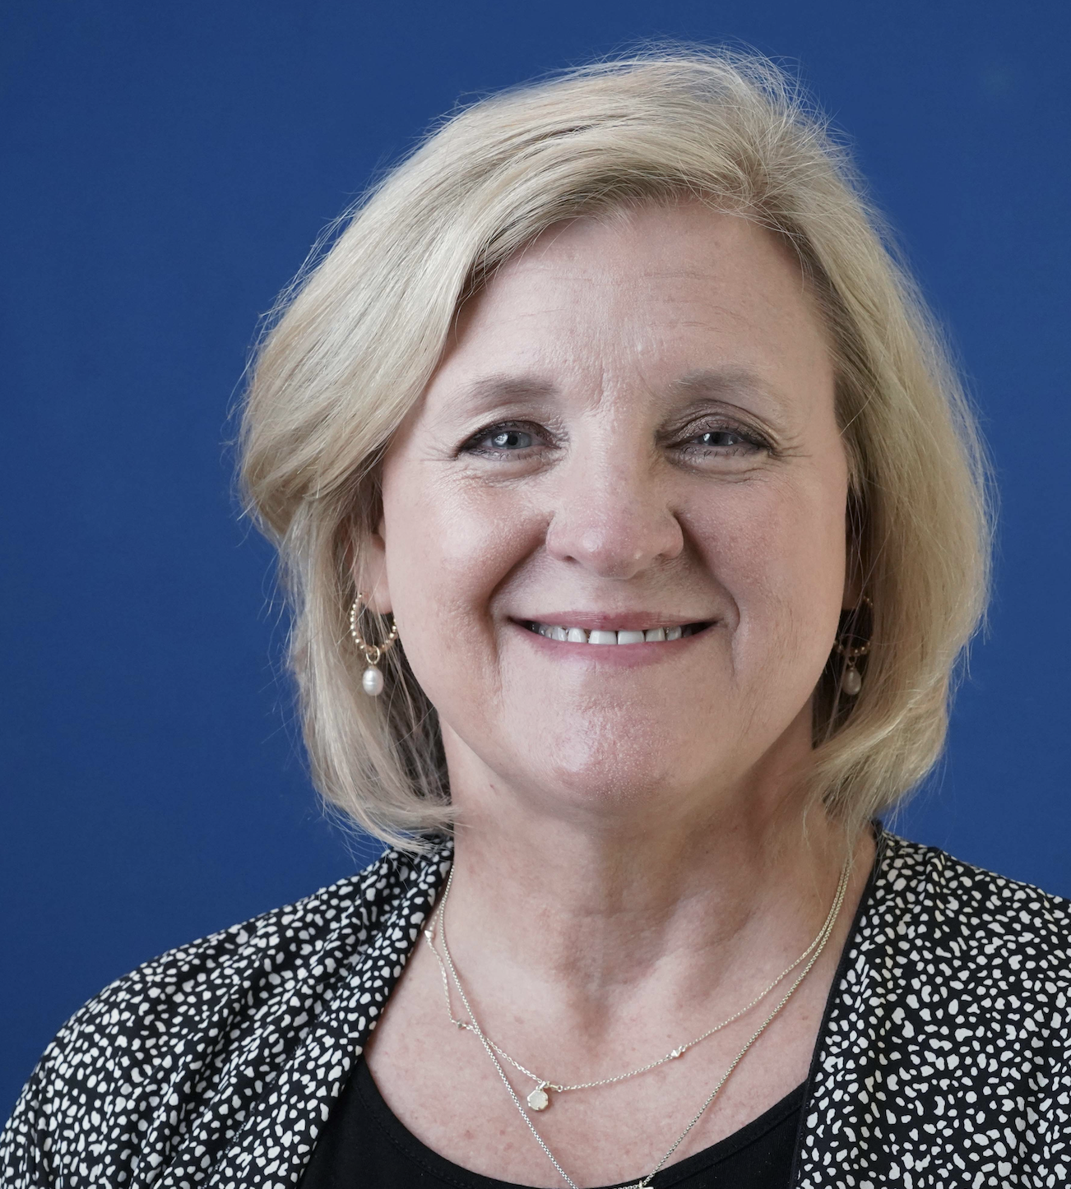
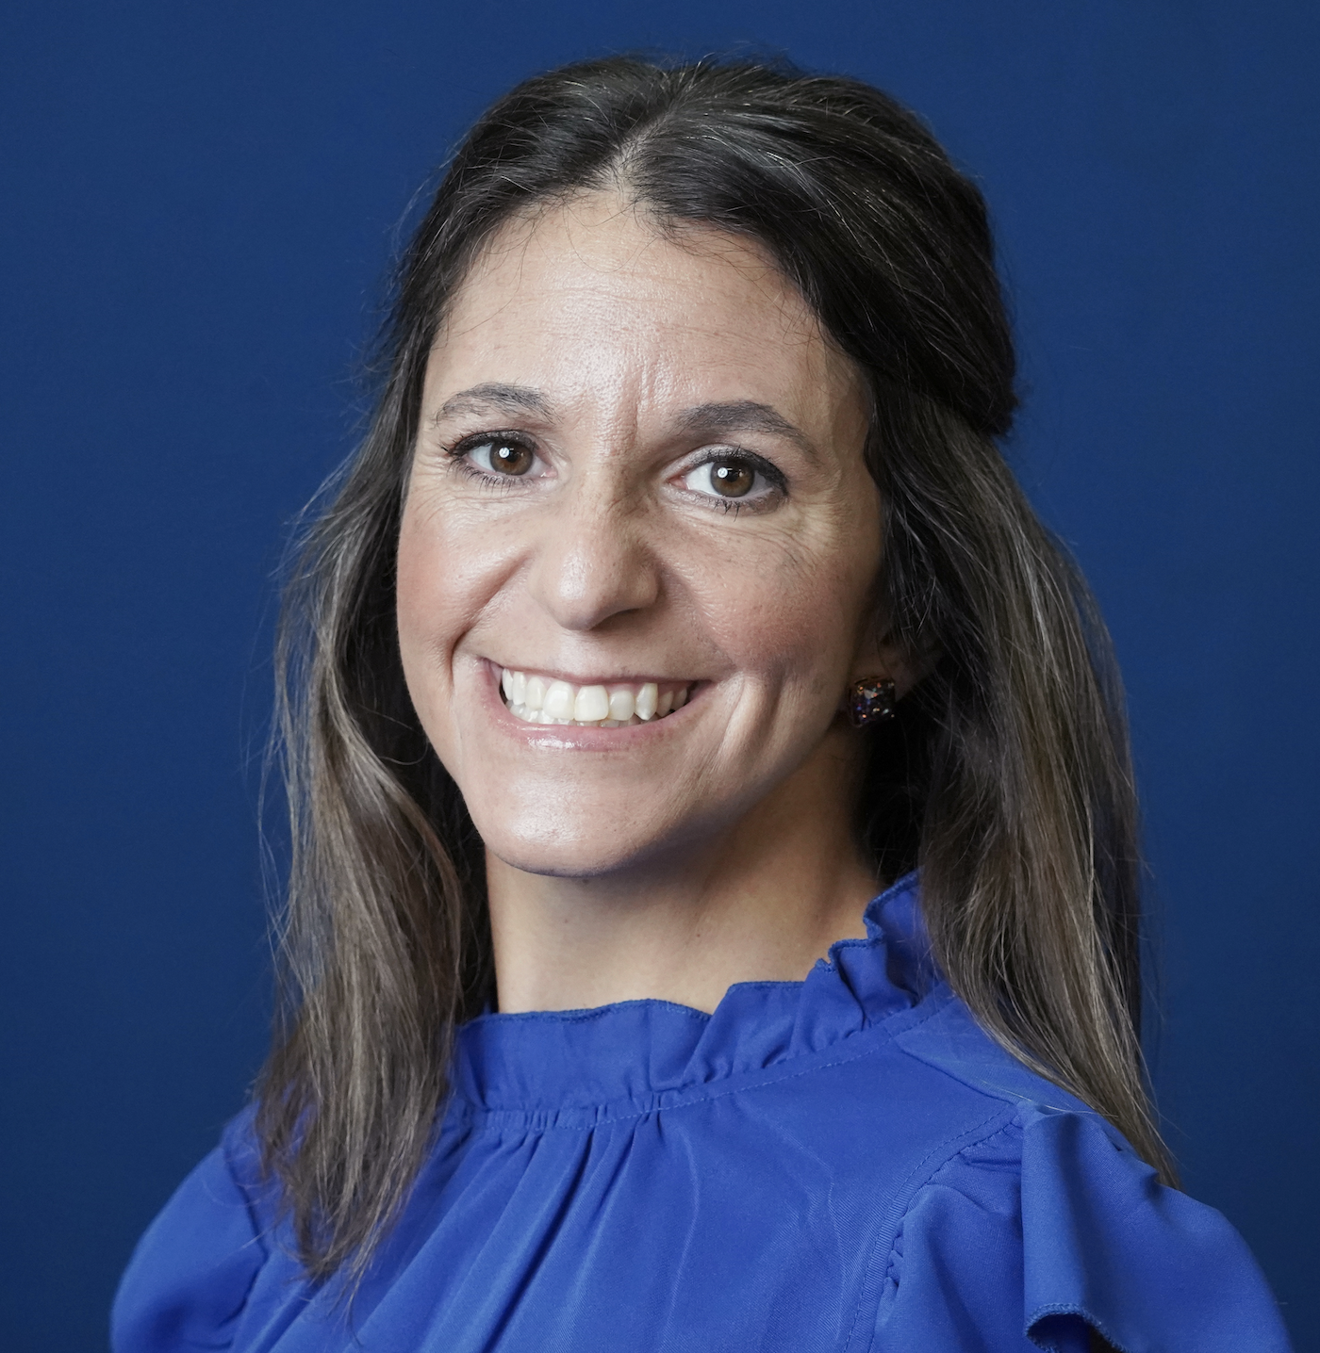
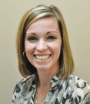
Dr. Michelle Parker
Dr. Mae Lane
Coordinator
Co-Founder
Dr. Jaime Coyne
Dr. Tori Hollas
Co-Founder
Co-Founder
Project Director

Slide 4
Contact:
mrparker@shsu.edu
832.296.1007
​

Slide 5
Program Overview
Students receive a baccalaureate degree, an M.Ed., and Texas Teacher Certification in five years.
Previously, the program was funded by the US Department of Education. This program is no longer grant funded, and students will have to pay for their classes.

Slide 6
Benefits
Graduate Degree-M.Ed. in Teaching & Learning
Paid Internship (paid by employing district)
University Supervision
Research Opportunities

Slide 7
Certification Areas
EC-6 Generalist
EC-6 Bilingual*
EC-12 SpEd*
4-8 Math*
4-8 Math/ Science*
4-8 ELAR/SS*
EC-12 Spanish*
EC-12 Theatre
​

Slide 8
District partners
Aldine ISD
Belton ISD
Brenham ISD
Bryan ISD
Clear Creek ISD
Cleveland ISD
Conroe ISD
Crosby ISD
Cy-Fair ISD
Hardin ISD
Humble IS
Huntsville ISD
Katy ISD
Klein ISD
Madisonville ISD
Magnolia ISD
New Caney ISD
New Waverly ISD
Onalaska ISD
Sealy ISD
SHSU Charter School
Splendora ISD
Spring ISD
Tomball ISD
Waller ISD
West Hardin CISD
Willis ISD
Groveton ISD
Lumberton ISD
Needville ISD
Royal ISD

Slide 9
Admissions

Slide 10
When do I apply?
First Semester of YLR/Field 3/Methods
First Semester of YLR/Field 3/Methods | Even or Odd and Starting Semester of 4+1
Spring Semester | You would be an Even Cohort (12) and start 4+1 in Summer

Slide 11
Required
3.00 GPA Overall or Last 60 SCH
Passed the Practice Content (including STR*) and Supplemental**
Have 120 hours and all other required courses scheduled to be completed before starting Master’s courses (in certain circumstances, you can have one class remaining)
Applications are open on February 2nd and close on March 1st at 11:59 p.m. for those who want to apply to Cohort 12.
**STR-If EC-6, or teaching reading in 4-8
                **Supplemental-Bilingual/SPED

Slide 12
Admission Checklist: Apply by
March 1st
Degree Works Transcript with 4+1 Checks
  (4+1 Check is Advising Meeting with COE Advisor)
Passed Practice Content/Supplemental by 80%

Slide 13
Timeline
If you are in 1st Semester of YLR/Methods during a Spring Semester, you would be an EVEN Cohort (12) and start 4+1 in Summer
Spring | Summer | Fall | Spring | Summer
Apply on ApplyTexas.org* -Continue YLR/Methods -Accepted into 4+1 *Directions for applying on next slide. | Take (3) 4+1 Graduate classes -Graduate with Bachelor’s in August | Internship I as Teacher of Record -Take (2) 4+1 Graduate Classes | Internship II as Teacher of Record -Take (2) 4+1 Graduate Classes | -Take (2) 4+1 Graduate Classes -Graduate with M.Ed in Teaching and Learning in August
 | CIED 5383 CIED 5393 SPED 5301 *4-8 will take Grad level TESL Course | BESL 5318 CIED 5398 | CIED 5370 CIED 5399 | CIED 5371 CIED 5382 CIED 5390

Slide 14
Directions for applying
Please submit your Summer 2024 Graduate Application on Apply Texas - https://goapplytexas.org
Begin a new Graduate application for the FALL 2024 semester (you will begin graduate courses in the summer but must apply for Fall 2024)
Select the Teaching and Learning 4+1, M Ed program
Complete the remainder of the application, answer supplemental and demographic questions, pay the $50 application fee, and click submit.
You will receive an email confirmation the following afternoon to create your SHSU Student Self-Service Account located at www.shsu.edu/checkstatus (This will come from the Grad Hub, so please do not email me about this. I can’t see it.)
This account is where you can monitor the status of your application
The Office of Admissions will provide copies of your transcripts – do not order official copies to be sent

Slide 15
Cohort 12
Cohort 12 will be for those who are in 1st Semester YLR/Methods right now.
Applications open February 2nd on ApplyTexas.org and will close on March 1st .
Final decisions will be made by March 29th
*Dates are tentative

Slide 16
FAQ's
Q: I have one remaining class. Can I take it and still be accepted?
A: Though we discourage you from taking courses with 4+1 graduate courses, it is possible. You will need to ensure they will be offered during the summer or next semester.
Q: Are classes online?
A: All our classes are online.
Q: Will I be paid as an Intern?
A: Yes, as a teacher of record, you will be paid by the school district.

Slide 17
FAQ's
Q: What can I do with a Master's degree?
A: Many school districts offer a stipend.
B. You can teach undergraduate classes.
C. You can be an instructional coach, curriculum director, etc.

Slide 18
If you are interested in Cohort 12:
What should you do now?
Schedule your 4+1 Check-In Advising Appointment
Pass the Content (or Practice) Exam, STR (EC-6, 4-8 SS/ELAR, 4-8 ELAR) and Supplemental (if you are Bilingual, SPED)
Submit your application

Slide 19
Any questions?

Slide 20
Contact me:
mrparker@shsu.edu
832.296.1007

