Slide 1
College of Sciences
2013 State of the College Address

Slide 2
Overview
Presentation of College Awards
Recognition of Tenure and Promotion
Dean’s Office and College Staff Introductions
New Faculty and Staff Introductions
Year in Review
  Legislative Update
  Enrollment and Teaching
  Research and Scholarship
  Service
  International Activities
Review of College Goals for 2012-2013
New Goals for 2013-2014

Slide 3
College of Science Excellence Awards
Graduate Student Excellence in Research -- Deepthika De Silva (Chemistry)
Student Excellence in Teaching -- Jesse Herring (Mathematics and Statistics)
Adjunct Faculty Excellence in Teaching -- Cheri Hudgeons (Mathematics and Statistics)
Faculty Excellence in Research -- Ilona Petrikovics (Chemistry)
Faculty Excellence in Service -- Doug Ullrich (Agricultural and Industrial Sciences)
Faculty Excellence in Teaching -- Mary Swarthout (Mathematics and Statistics)

Slide 4
Faculty Tenure and Promotions
Tenure and Promotion to Associate Professor
  Kyle Stutts (Agricultural and Industrial Sciences)
  Lei Chen (Computer Science)
  Joseph Hill (Geography and Geology)
  Linda Zientek (Mathematics and Statistics)
  Luis Garcia (Mathematics and Statistics)
  Joel Walker (Physics)
Promotion to Professor
  Marcy Beverly (Agricultural and Industrial Sciences)
  Dwayne Pavelock (Agricultural and Industrial Sciences)
  Melinda Holt (Mathematics and Statistics)

Slide 5
Dean’s Office
Dean-Dr. John Pascarella
Associate Dean of Curriculum and Assessment-Dr. Marcus Gillespie
Associate Dean of Research and Graduate Programs-Dr. Anne Gaillard
Assistant to the Dean-Tammy Gray
Senior Administrative Assistant-Rhonda Baxter
Administrative Assistant-Shellie Armstrong
Staff Assistant- Susan Floyd (NEW)

Slide 6
Organizational Changes
Effective Sept. 1, Department of Nursing becomes the School of Nursing and moves from College of Sciences to new College of Health Sciences (Dean Michael Lacourse)
Medical and Allied Health Programs (MAHP) also moves to new College of Health Sciences
College of Health Sciences Dean’s Office and MAHP on 2nd floor of LDB across from COS Dean’s Office

Slide 7
New Faculty and Staff Introductions
New DELTA COS Instructional Design Specialist
(LDB Rm 145)-M. Kathy Chisum
New DELTA COS Web Content Specialist-John Holder (jmholder@shsu.edu)

Slide 8
Legislative impact
  THECB (Texas Higher Education Coordinating Board) lost power to close programs due to low numbers; can still make a recommendation to Board of Regents to close programs
  No TRB (Tuition Revenue Bonds) were approved for any state university system; Biology/Nursing building not approved by Texas Legislature-will continue to use existing facilities for at least 4-5 years

Slide 9
Enrollment and Teaching

Slide 10
In 2013 Largest College by Majors at SHSU Data as of 8/27/2013
College Total Count
Business Administration 3422
Criminal Justice 3155
Education 3717
Fine Arts and Mass Comm 1851
Health Sciences ?
Humanities and Social Sciences 2789
Sciences 4242
No College Designated 50
Grand Total 19226
22% of all SHSU students are in this college.
In 2012, COS had 3815 students ~this date. Up 11%

Slide 11
2013/2012
Freshman 1323/1195
Sophomore 906/836
Junior 859/741
Senior 946/860
Masters 199/149
Post Baccalaureate 6/34
College of Sciences 4242
Grand Total 19,226

Slide 12
Credit Hours
Compared to 2012, 53,515, Up 6%
24.8% of all credit hours from Sciences
No College Designated 24
Business Administration 34,010
Humanities and Social Sciences 64,817
Academic Affairs 2,797
Criminal Justice 20,847
Sciences 56,524
Fine Arts and Mass Comm. 17,424
Education 31,468
Grand Total 227,911

Slide 13
College of Science Graduates
 | Fall 2011/ Fall 2012 | Spring 2012/ Spring 2013 | Summer 2012/ Summer 2013
Undergraduate | 190/191 | 243/279 | 83/109
Graduate | 26/23 | 44/37 | 15/20
Total | 216/214 | 287/316 | 98/129
Undergraduate up by 12%, graduate down 6%

Slide 14
Teaching
Teaching Awards and Accomplishments
  Agriculture faculty won national teaching awards (Dr. Kelley, Dr. Beverly, and Dr. Lane) from NACTA
  National Agricultural Teaching Assistant Award of Merit presented to Ms. Casey Page, MS in Agriculture
  Dr. Todd Primm was a NSF Vision and Change Leadership “PULSE” Fellow

Slide 15
Teaching
Curriculum and Degree Programs
  Core curriculum approved
  Graduated two classes of nursing graduates with 88% pass rate on licensing exam
  First BS in Biomedical Science graduates
  PhD in Forensic Science and PhD in Instructional Technology approved by TSUS BOR; COS faculty involved with both programs

Slide 16
Teaching
Curriculum and Degree Programs
  TSUS BOR approval for new BS degrees in CS and AGIT; THECB review underway
    Bachelor of Science with a major in Agricultural Communications
    Bachelor of Science with a major in Electronics and Computer Engineering Technology
    Bachelor of Science with a major in Software Engineering
  Developing Full Proposal for PhD in Digital Forensics
  Developing an Online Master of Agriculture degree in Sustainable Agriculture and Food Environment (SAFE)

Slide 17
Research and scholarship

Slide 18
Faculty Research Grant: 4 out of the 10 awards were to COS
Chen, Lei
“Investigating Steganography and Digital Forensics in Video Games”
Neudorf, Diane
“Fledgling survival in urban and forested ecosystems”
Varol, Cihan
“Diagnosing Liver Cirrhosis with Communications Technology”
Walker, Joel
“Testing No-Scale F-SU(5) at the Large Hadron Collider”
Deadline to apply is Oct. 14, 2013

Slide 19
Enhancement Research Grants: 6 out of the 10 awards were to COS
Cook, Tamara
“Gregarines Parasitizing Zygoptera along the U.S. Gulf Coast”
Haines, Donovan
“Human Decomposition Volatile Measurement For Microbiological Correlation”
Harper, James
“Mitochondrial Membrane Lipids and Aging in Diverse Taxa”
Mukherjee, Falguni
“Actor Networks of GIS Construction in India”
Seeling, Joni
“PP2A B56 regulatory subunits as tumor suppressors”
Wozniak, Jeffrey
“Investigating the role of Hydrological Connectivity in Coastal Ecosystems”
Deadline to apply is Oct. 7, 2013

Slide 20
External Funding Applications, Awards and Active Grants (9/1/12-8/31/13)
Department | # Apps | $ | # New Awards | $ | # Active Awards | $
Agricultural and Industrial Sciences | 10 | $1,702,737 | 6 | $1,180,694 | 4 | $120,352
Biology | 9 | $1,399,289 | 2 | $324,265 | 6 | $82,852
Chemistry | 4 | $752,780 | 2 | $379,557 | 1 | $37,908
Computer Science | 1 | $353,267 | 1 | $249,997 | 1 | $111,809
Geography/Geology | 0 | $0 | 1 | $100,000 | 1 | $26,370
Math and Statistics | 6 | $1,631,959 | 3* | $86,833* | 5 | $310,282
Physics | 4 | $265,805 | 1 | $20,310 | 1 | $37,130
Total | 34 | $6,105,837 (up 9% over 2012 | 16* | $2,325,823* | 19 | $726,703
*Indicates additional pending award (amount not yet determined)

Slide 21
Selected Awards and Active Grants
2012-2013
Agriculture/Industrial Technology- Received major award on renewable energy education from USDA (>$750,000); new relationships with Texas Military Forces for multiple contracts
Biology-Received pilot funding for Bio-Math collaboration (ECO-IMPACTS); NSF, DIJ, Texas Parks & Wildlife
Chemistry-Continued Army funding of Dr. Petrikovics on cyanide antidotes; continued Welch Foundation funding
Geology-Dr. Acton bringing NSF grant to SHSU
  Math and Statistics-continued with second year of summer REU in Hawaii ; Received notification of funding for NSF REU for 3 years beginning 2014 (Dr. Chapman, PI)
Physics-Dr. David Pooley and Joel Walker both received grants for research and collaboration;

Slide 22

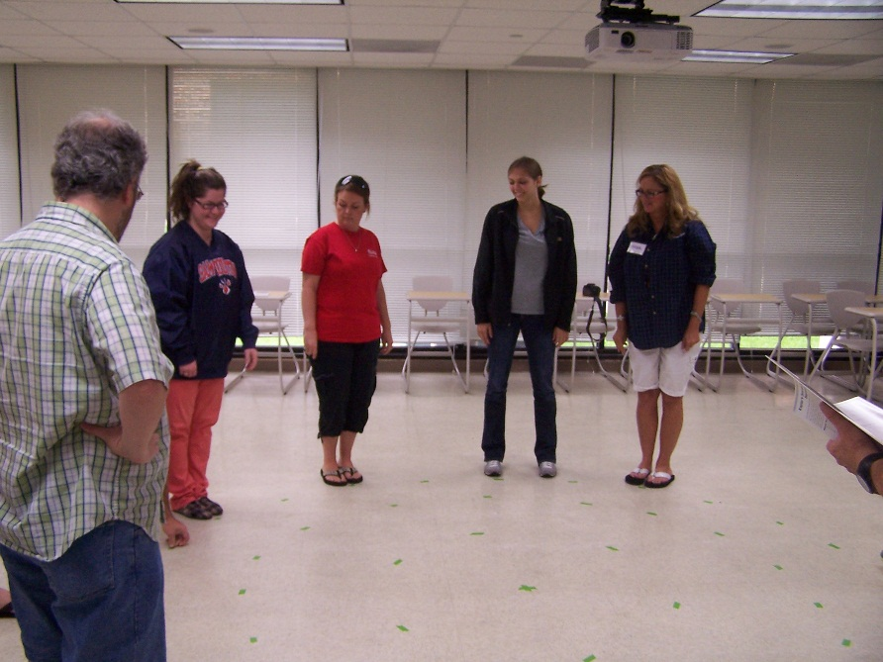
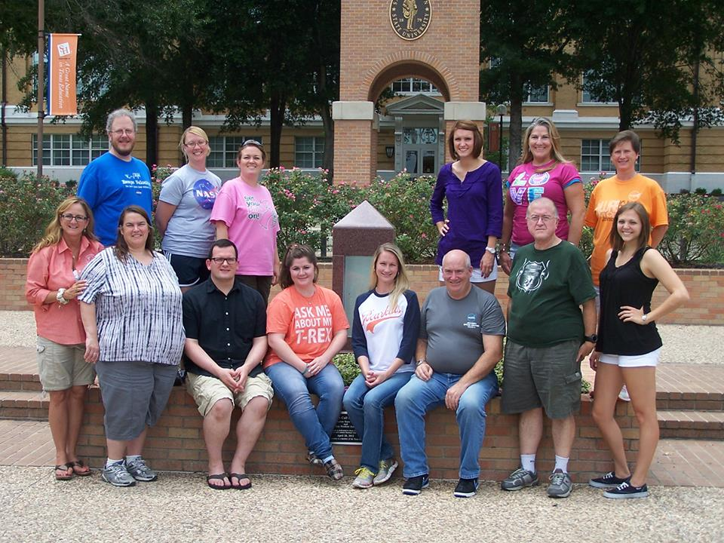
ASSET: Astronomy Summer School of East Texas
15 July – 26 July 2013
Eleven secondary science educators (2 pre-service teachers and 9 teachers hailing from four school districts in Texas) gathered at Sam Houston State University for ASSET this summer. Since virtually every science class from grades 6-12 incorporates some unit on astronomy, and because science literacy is flagging in the East Texas region, the Co-I’s provided a 2-week astronomy immersion class for regional teachers, employing research-based astronomy education techniques and NASA mission data. Teachers assumed the role of students, exploring for themselves how to approach astronomical questions from the ground up. The participants visited NASA’s Johnson Space Center and Space Center Houston, where they also spent time at the NASA Educator Resource Center. The culminating event was a day of team presentations where they test-drove their own activities for the group.
The investigators plan to follow up with the participants, administering pre- and post-content and science attitude surveys to their students, to find out whether the immersion in astronomy will have a measurable effect on their students.
22
C. Renee James (phy_crj@shsu.edu)
Scott T. Miller (stm009@shsu.edu)
THE HUMAN ORRERY

Slide 23

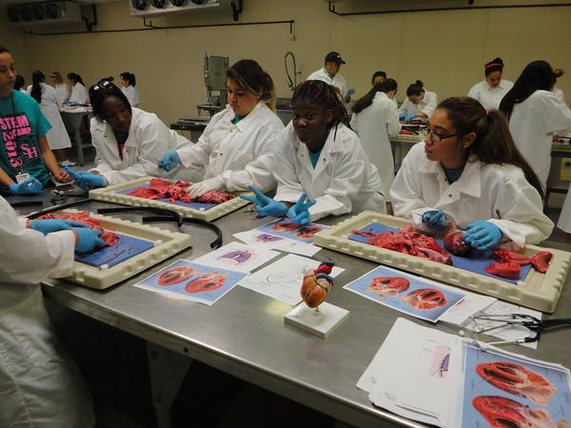
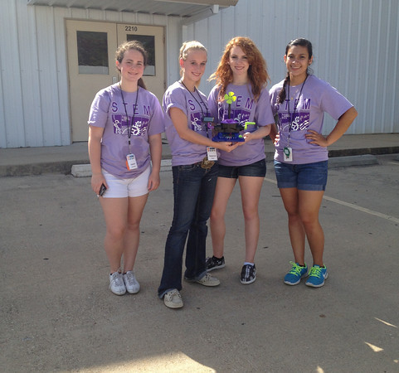

Slide 25
SERVICE

Slide 26
Dr. Renee James is Chair of Faculty Senate 2013-2014
Rick White continues to work as a DAAD Research Ambassador
Linda Zientek was awarded the Southwest Educational Research Association (SERA) Extended Service Award in February
Bill Jasper is President (2011-2012) and Past President (2012 - 2013) of Southwest Educational Research Association (SERA), a regional organization associated with the national American Educational Research Association (AERA)
Dusty Jones was elected as president of the Association of Mathematics Teacher Educators - Texas Affiliate (AMTE-TX)

Slide 27
Editorships
Dr. Don Albert of Geography and Geology serves as editor of the International Journal of Applied Geospatial Research
Dr. Scott Chapman of Math and Statistics is editor of The American Mathematical Monthly, the premier journal of the Mathematical Association of America
Dr. Stanley F. Kelley of Agricultural and Industrial Sciences serves as Associate Editor – Texas Journal of Natural Resources
Dr. Kyle Stutts of Agricultural and Industrial Sciences serves as Associate Editor – Journal of North American Colleges and Teachers of Agriculture

Slide 28
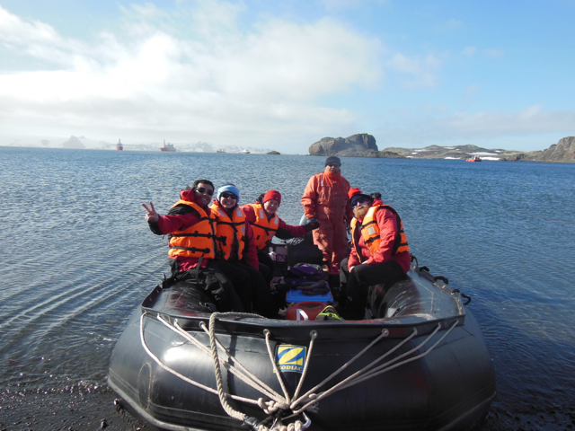
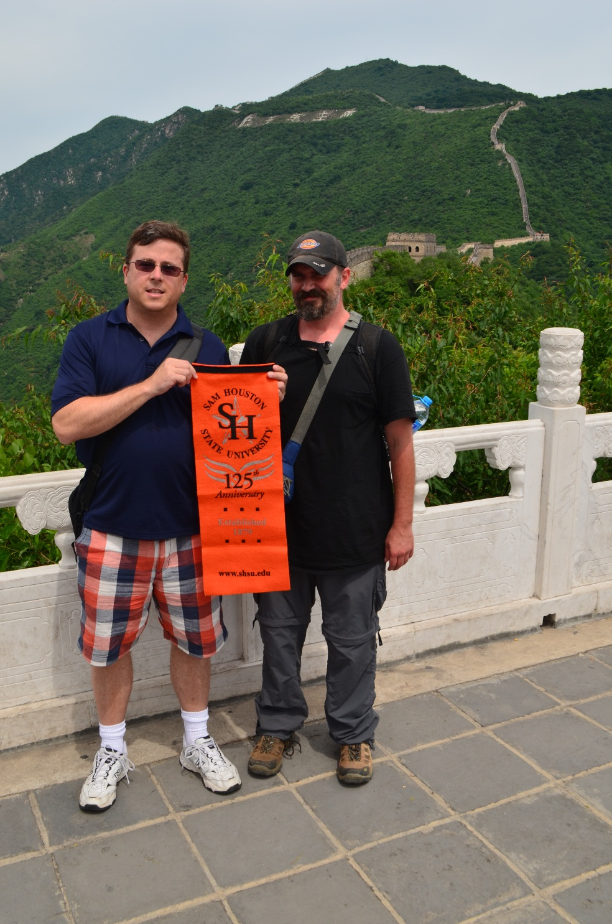
International
Activities
Tom Chasteen (Chemistry)
and colleagues in Antarctica
Chris Randle (Biology) and Dean Pascarella
display propaganda on the Great Wall

Slide 29
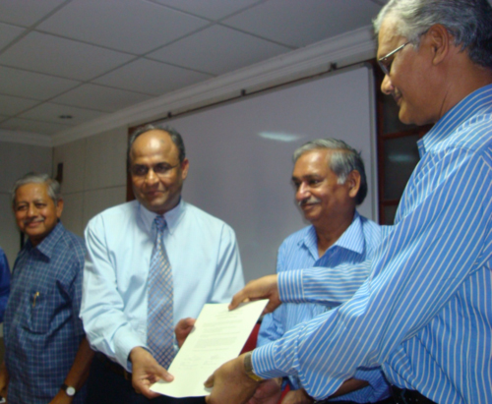
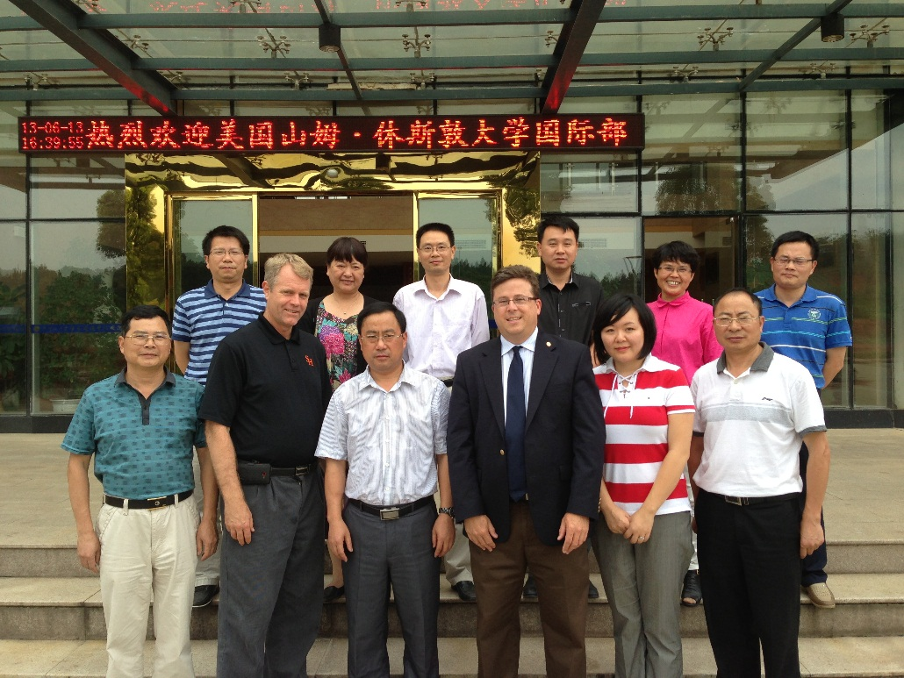
Increased International Opportunities
Dr. Choudhary and officials from Patna University, India sign MOU
Dean Pascarella visits Jinggangshan University, China

Slide 30
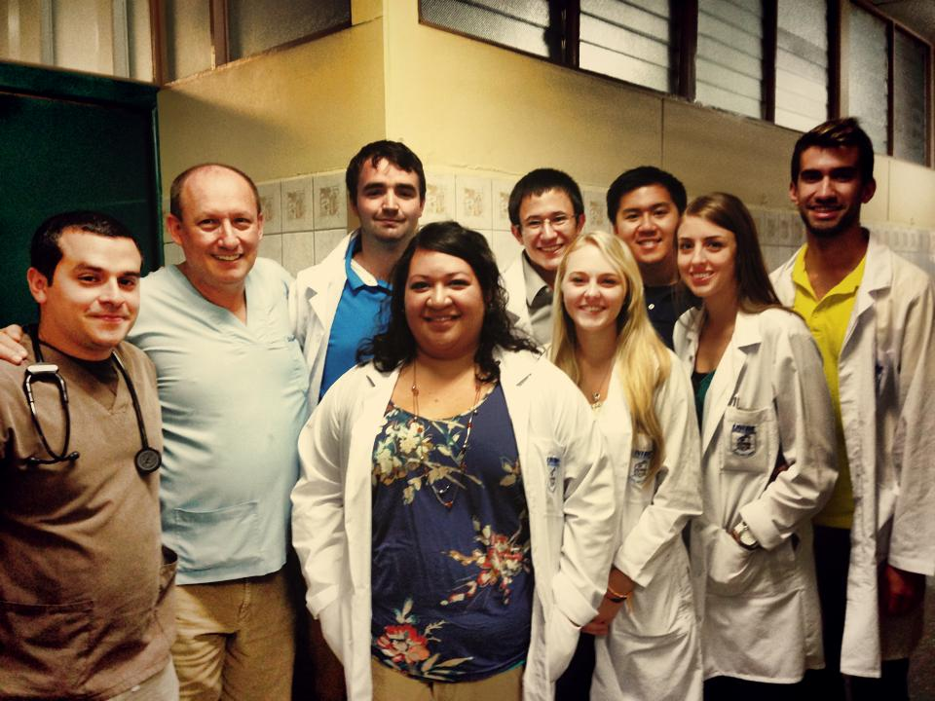
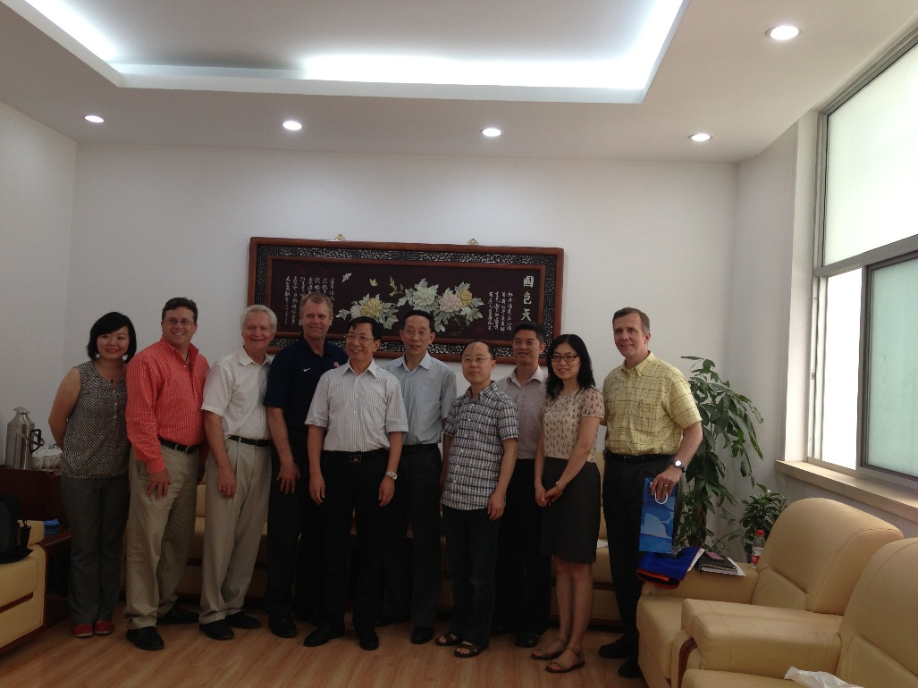
Faculty and students FROM COS were in Latin America, Africa, Europe, Asia, and Antarctica last year
Dr. Gaillard takes Biology course to Costa Rica
Dr. Pascarella visits Beijing Mining and Technology University, China

Slide 31
Review of Goals for 2012-2013

Slide 32
Review of FY13 Goals for COS
Increase Online Core Offerings
  Developed additional online courses in Agriculture, Biology, Computer Science, Geography, and Math
Expansion of Woodlands Center Courses/Programs
  Chairs met in fall 2012 to tour facility and examine space potential ; Identified possible programs in CS and GIS
Accreditation of Academic Programs
  CS reaccredited to Fall 2015
  Nursing received 5-year accreditation

Slide 33
Review of FY13 Goals for COS
Grow graduate program enrollment and programs
  Increased enrollment in Chemistry and Computer Science
  Graduate program in Agriculture had successful review session
  Math increasing TA’s in lieu of pool faculty for some courses

Slide 34
Review of FY13 Goals for COS
Plan for needed infrastructure
  Programming for new Engineering Technology/Agriculture Building underway
  Most of the Biology Natural History Collections moved to TRIES (SHSU Nat. Hist. Museum)
  New $1.5 Million Vivarium (Animal Care Facility) approved and in bid
  Old Animal Care Facility to be used for Geology student and faculty research labs (pending)
  Moore Supply Building to be used for Geology Core Facility (undergoing renovation)

Slide 35
Review of FY13 Goals for COS
Promote Undergraduate Research
  Launched College URG program
Develop a College Promotion and Tenure Committee
  Committee reviewed and recommended to retain existing structure
  Enhanced emphasis on detailed departmental and chair review annually of all probationary faculty
Recognize Faculty and Graduate Student Excellence
  Launched Awards program

Slide 36
Review of FY13 Goals for COS
Support External Grant Preparation and Research in COS
  Provided supplemental funding for Pilot Grant (Eco-Impacs)
  Provided start-up funds for new faculty
  Provided research funds for grant-active faculty
Create a mission/vision for COS
  Faculty developed Mission and Vision Statements (on COS website)
Promote COS accomplishments internally and externally
  Faculty and students featured prominently in Heritage Magazine and SHSU websites

Slide 37
Priorities for 2013-2014
Develop strategic plans for managing growth in classes required in the core and for Health Sciences students
Review existing space allocation in Lee Drain and Farrington to accommodate needed lab space for teaching and research
  Obtain funding for renovation of teaching labs
Review possibility of reviving the Environmental Science program as a true interdisciplinary degree from BS to PhD

Slide 38
Priorities for 2013-2014
Examine cross-cutting research strengths to identify areas for enhanced research and programmatic growth
Enhance international collaborations with Chinese and Indian universities and in Costa Rica with UNIBE Health Sciences University
Prepare for full core implementation in fall 2014
Work with advancement to develop funding proposals for facilities, faculty, and student support

Slide 39
Have a great year!
Please provide your input into all of these areas through your departmental meetings, faculty senate representatives, and other venues
I will be visiting with each department during the year to discuss how we can improve teaching and scholarship within the COS

Slide 40

Eat ‘em Up, Kats!

